Slide 1


REST API Authentication Mechanism
Navnath Damale | 2020 November 27

Slide 2

Introduction
Classic session-based authentication
Basic Authentication
Better Solutions
Demo
Q & A
Agenda

Slide 3
REST API Authentication | Introduction
Stateful Application
Stateless Application
clairvoyantsoft.com

Slide 4
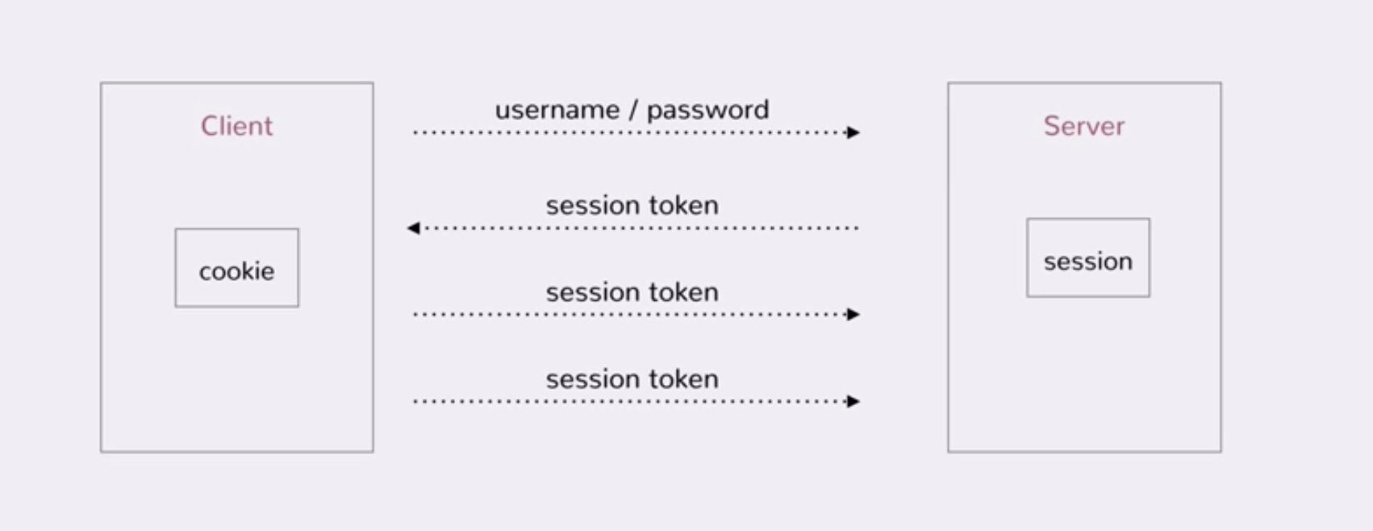
REST API Authentication | Classic session-based authentication
clairvoyantsoft.com

Slide 5
REST API Authentication | Classic session-based authentication
REST APIs are stateless!
clairvoyantsoft.com

Slide 6
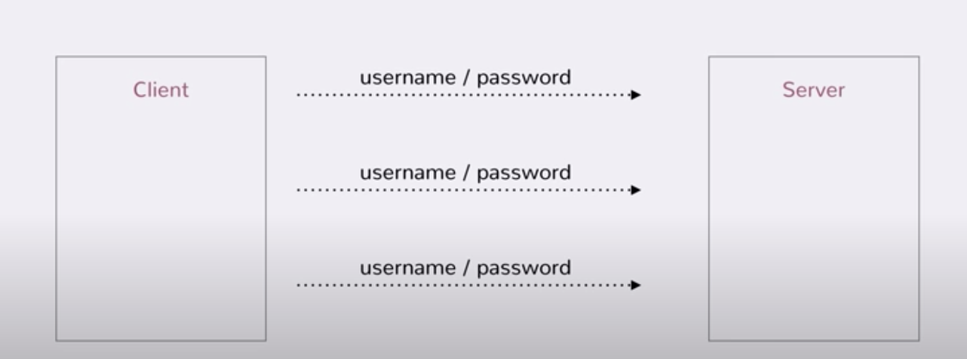
REST API Authentication |Basic Access authentication
clairvoyantsoft.com

Slide 7
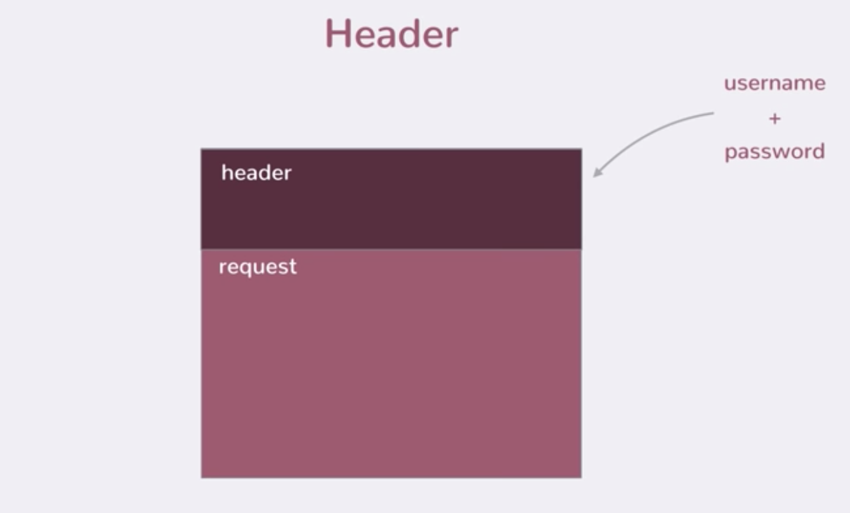
REST API Authentication |Basic Access authentication
clairvoyantsoft.com

Slide 8
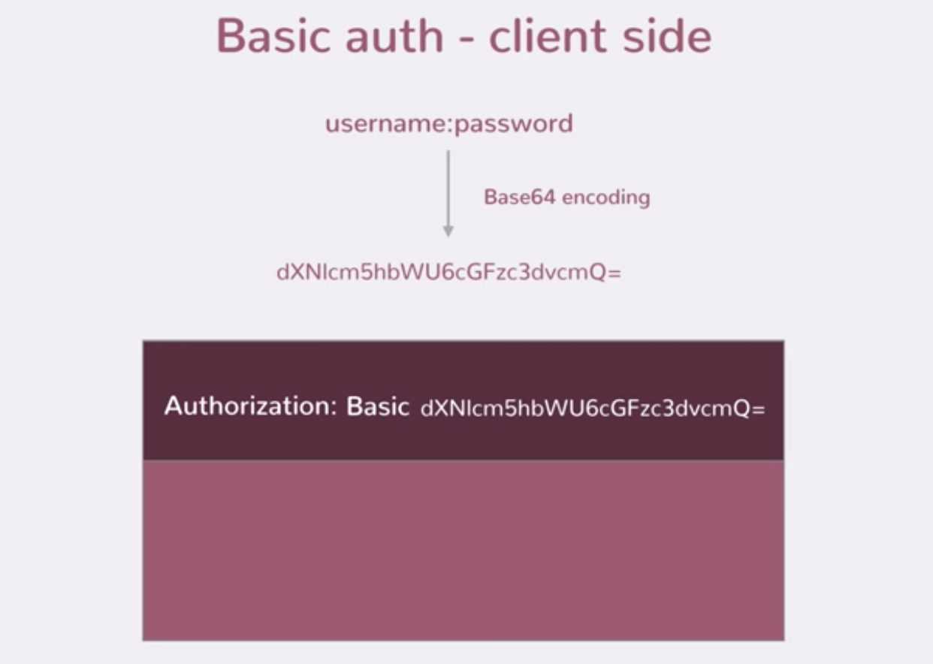
REST API Authentication |Basic Access authentication
clairvoyantsoft.com

Slide 9
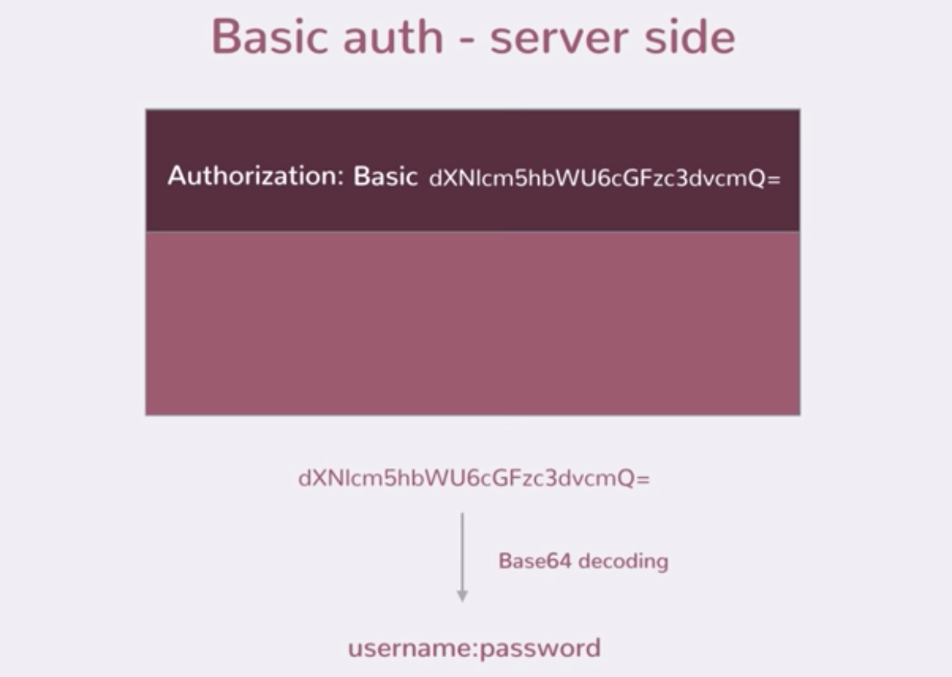
REST API Authentication |Basic Access authentication
clairvoyantsoft.com

Slide 10
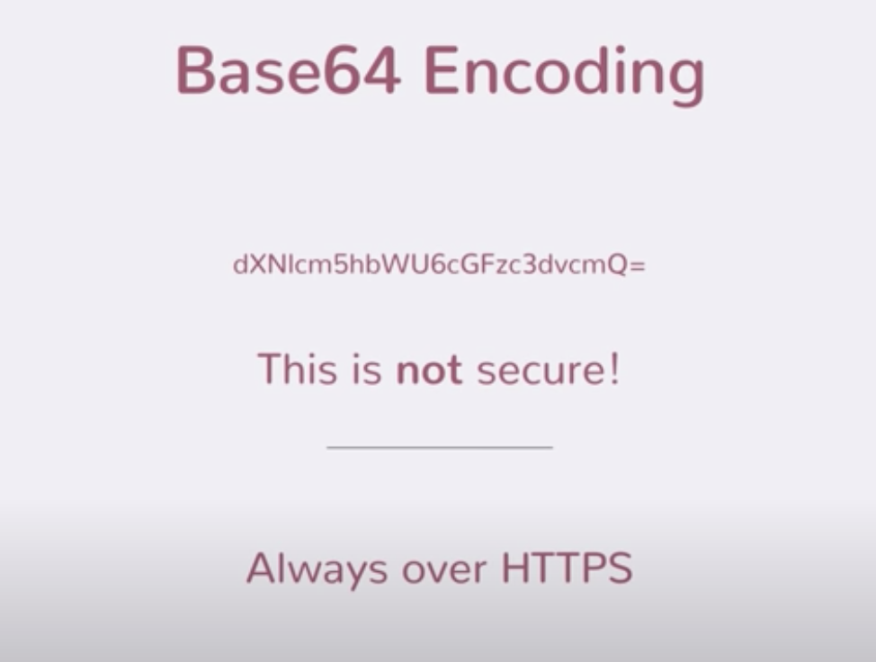
REST API Authentication |Basic Access authentication
clairvoyantsoft.com

Slide 11
REST API Authentication |Basic Access authentication
Advantages
- Simple
Stateless server
Supported by all browser
Disadvantages
- Requires HTTPS
- Subject to reply attacks
- ”Logout” is tricky (Browser caching)
clairvoyantsoft.com

Slide 12
REST API Authentication |Better solution
OAuth
JSON Web Tokens
Asymmetric cryptography
clairvoyantsoft.com

Slide 13
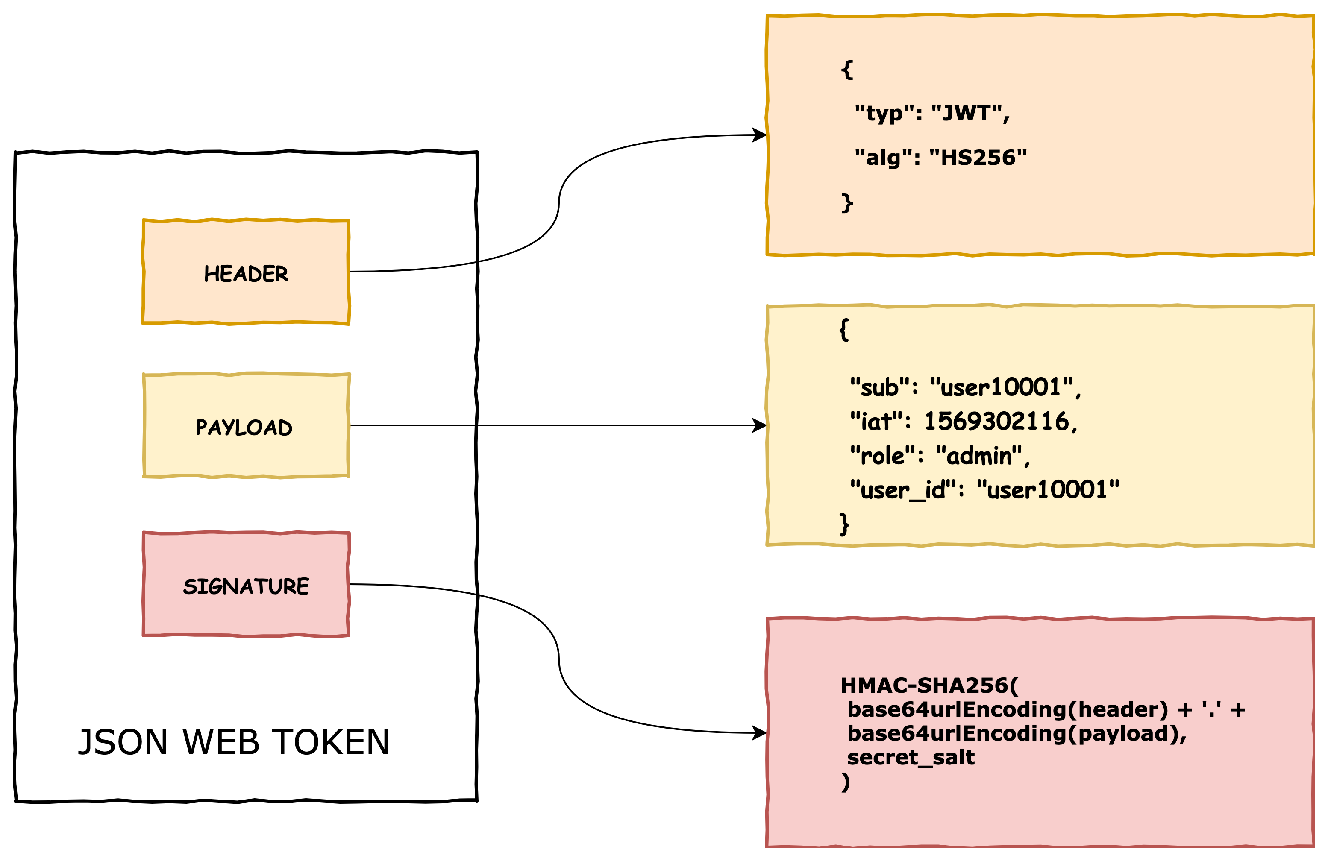
REST API Authentication |JSON WEB Token
clairvoyantsoft.com

Slide 14
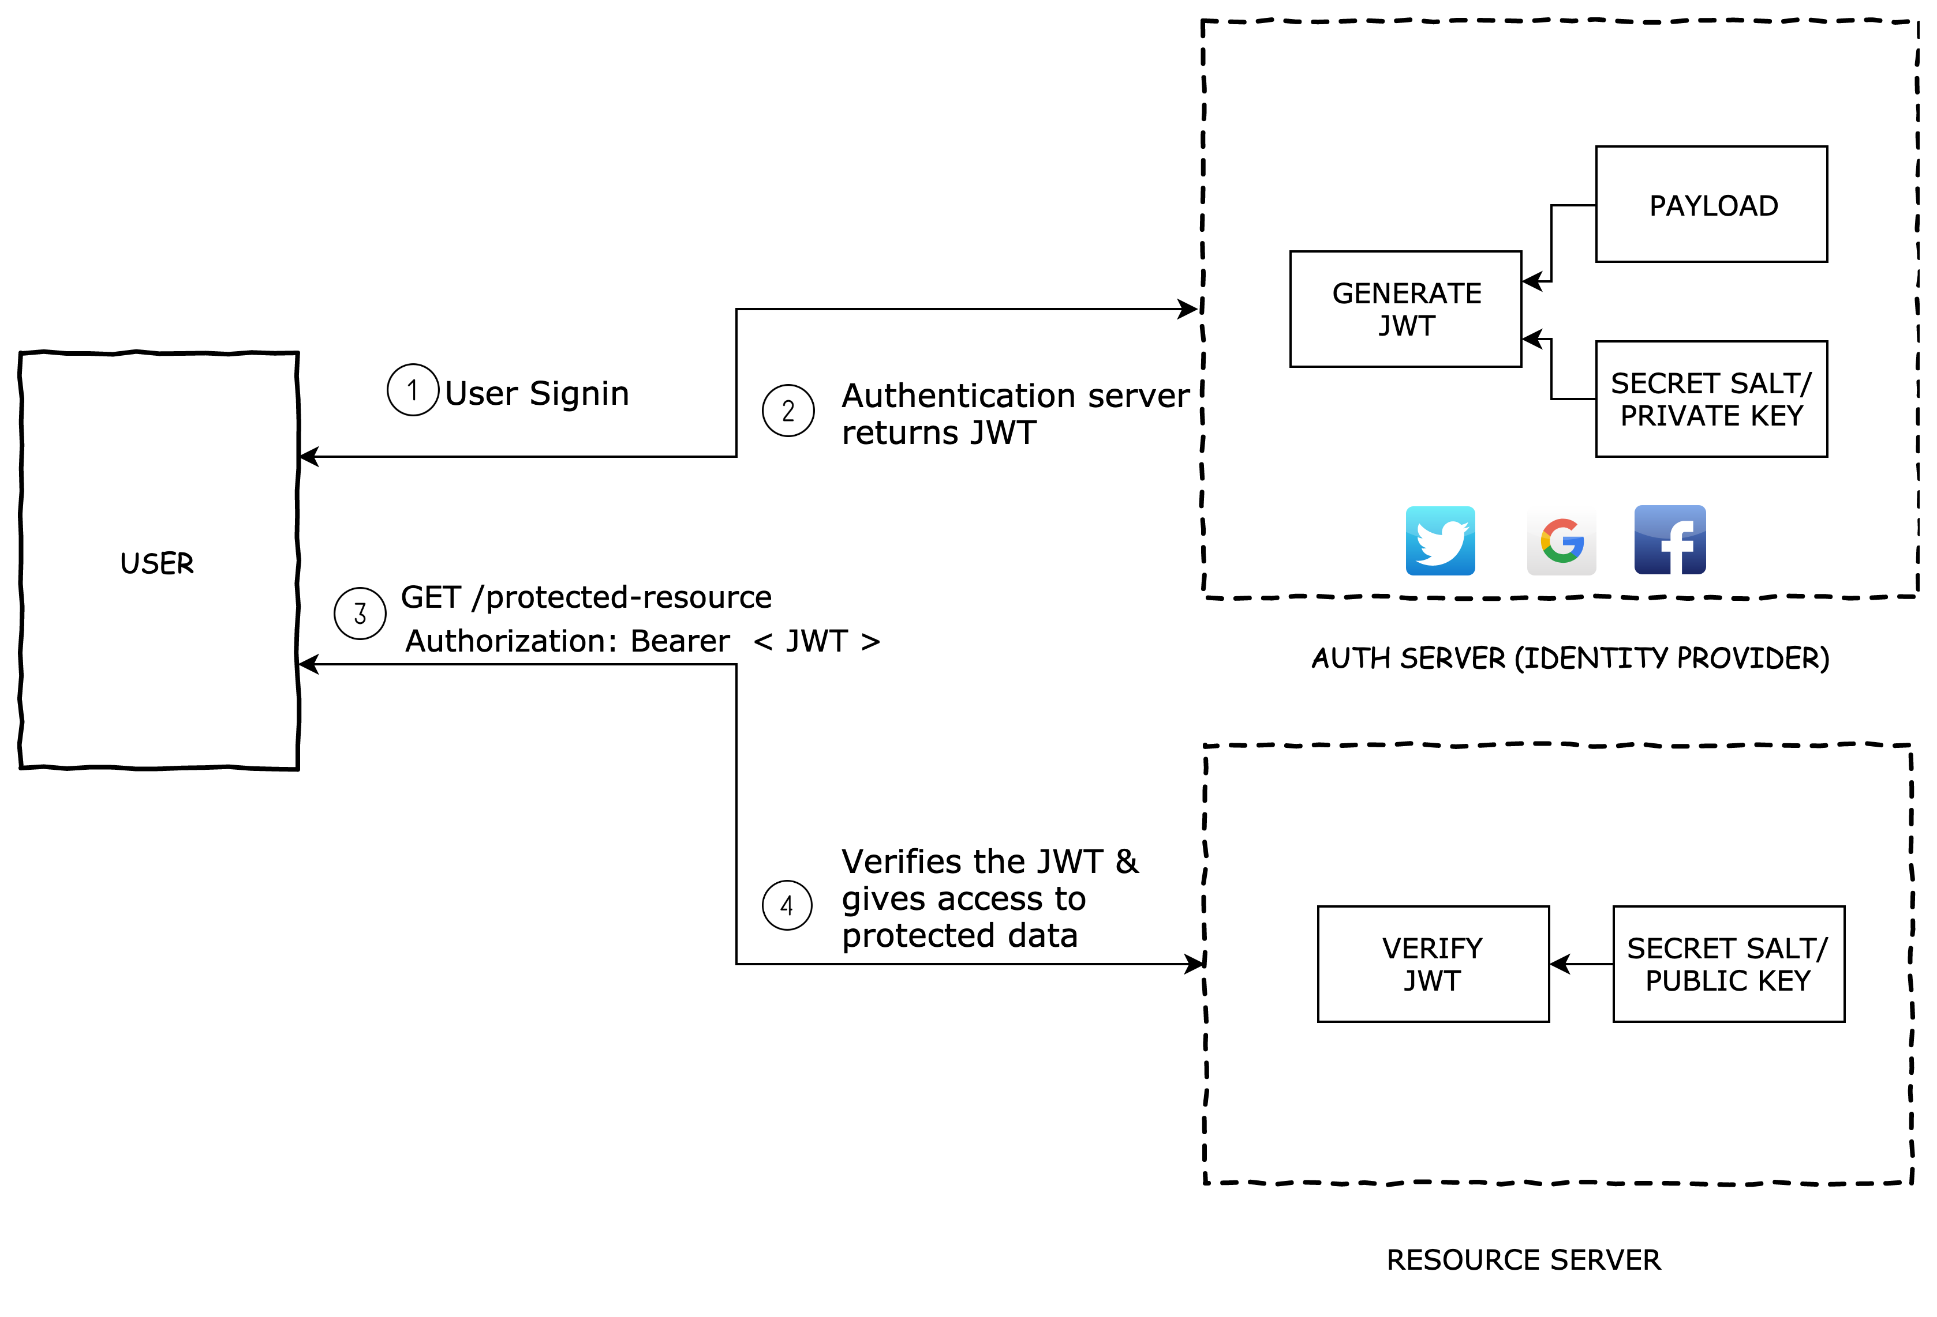
REST API Authentication |JSON WEB Token
clairvoyantsoft.com

Slide 15

GraphQL | In Practice
Demo Time
clairvoyantsoft.com

